Slide 1
Build a Regression Package

Slide 2
Table of Contents
Motivation and Insights
Linear Regression
Approach
Result Interpretation
Challenges and Roadblock
Roadmap Ahead/ Future Work

Slide 3
Motivation and Insights:
Our motivation for this project is to gain experience and insight into accurately simulating a model that is reflective of trading models used by large investment firms and banks.
Our primary focus is on developing a linear regression method since this component is most relevant to the problem we were determined to solve.
The formula for the beta coefficient of a single stock is exactly the same as that used to determine the slope of the best-fit line in linear regression

Slide 4
Linear Regression:
Linear regression attempts to model the relationship between two variables by fitting a linear equation to observed data. One variable is considered to be an explanatory variable, and the other is considered to be a dependent variable.
Y = a + bX,
where X is the explanatory variable and Y is the dependent variable. The slope of the line is b, and a is the intercept (the value of y when x = 0).
Three major uses for regression analysis are:
(1) determining the strength of predictors,
(2) forecasting an effect, and
(3) trend forecasting.
Notes:
Three major uses for regression analysis are (1) determining the strength of predictors, (2) forecasting an effect, and (3) trend forecasting.
First, the regression might be used to identify the strength of the effect that the independent variable(s) have on a dependent variable. Typical questions are what is the strength of relationship between dose and effect, sales and marketing spending, or age and income.
Second, it can be used to forecast effects or impact of changes. That is, the regression analysis helps us to understand how much the dependent variable changes with a change in one or more independent variables. A typical question is, “how much additional sales income do I get for each additional $1000 spent on marketing?”
Third, regression analysis predicts trends and future values. The regression analysis can be used to get point estimates. A typical question is, “what will the price of gold be in 6 months?”

Slide 5
Approach:
Visualizing the data
Performing simple linear regression
( Creating a model)
Interpreting Results
Reading and understanding the data
Predictions on the test set
Notes:
Three major uses for regression analysis are (1) determining the strength of predictors, (2) forecasting an effect, and (3) trend forecasting.
First, the regression might be used to identify the strength of the effect that the independent variable(s) have on a dependent variable. Typical questions are what is the strength of relationship between dose and effect, sales and marketing spending, or age and income.
Second, it can be used to forecast effects or impact of changes. That is, the regression analysis helps us to understand how much the dependent variable changes with a change in one or more independent variables. A typical question is, “how much additional sales income do I get for each additional $1000 spent on marketing?”
Third, regression analysis predicts trends and future values. The regression analysis can be used to get point estimates. A typical question is, “what will the price of gold be in 6 months?”

Slide 6
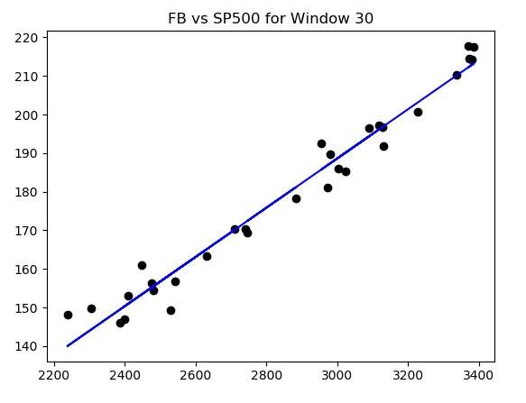
Line of Best Fit:
The Line of Best Fit is used to express a relationship in a scatter plot of different data points.
It is an output of regression analysis and can be used as a prediction tool for indicators and price movements
In general, a model fits the data well if the differences between the observed values and the model's predicted values are small and unbiased.

Slide 7
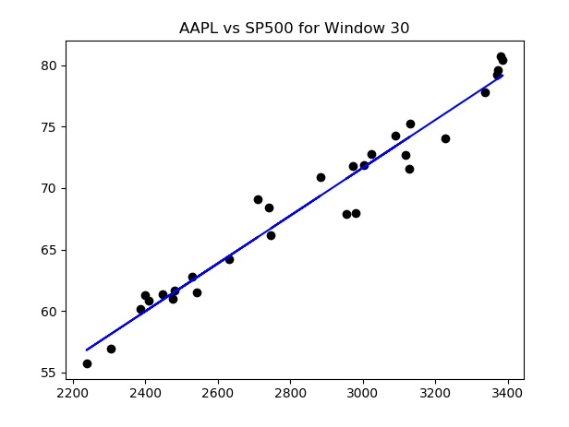
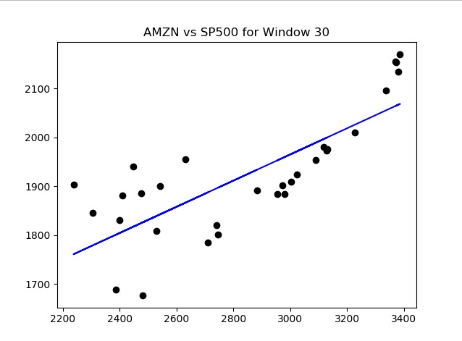
Line of Best Fit:

Slide 8
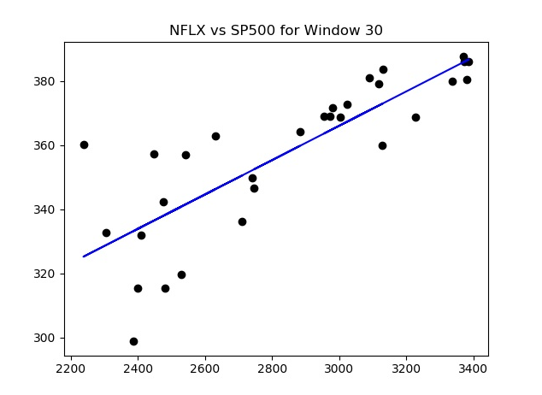
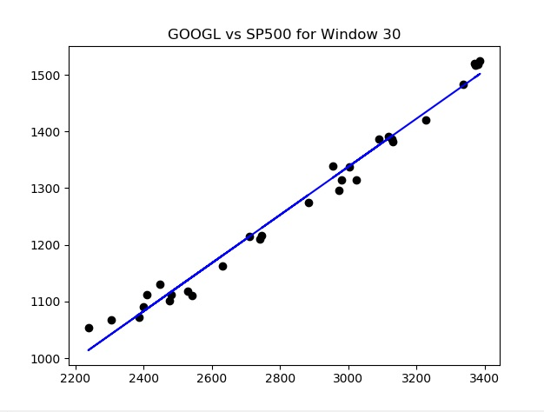
Line of Best Fit:

Slide 9
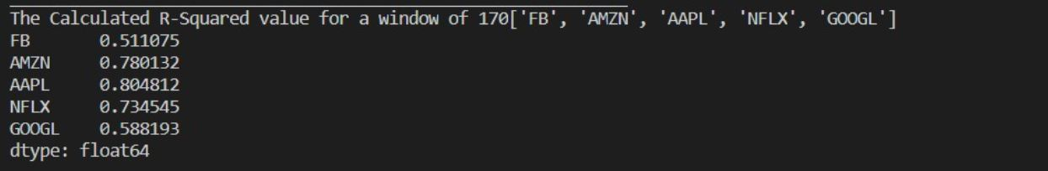
Result Interpretation:
R Squared Value - It represents the percentage variation in the dependent variable that is explained by the independent variable .

Slide 10
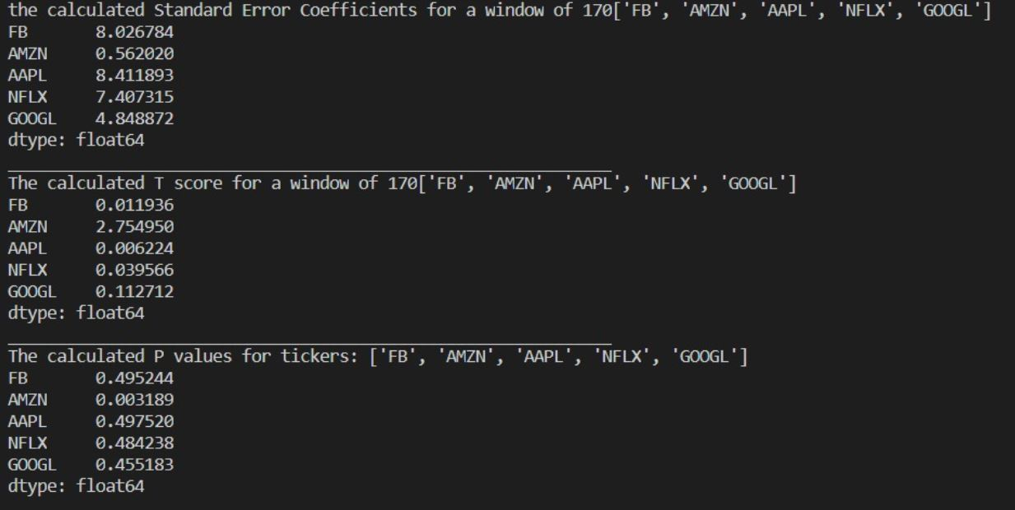
Result Interpretation:
Standard Error-The standard error of the coefficient to measure the precision of the estimate of the coefficient.
T score – Dividing the coefficient by its standard error calculates a t-value.
P Value- The p-value is the probability of obtaining results at least as extreme as the observed results of a statistical hypothesis test, assuming that the null hypothesis is correct.
Notes:
. The p-values for the coefficients indicate whether these relationships are statistically significant.

Slide 11
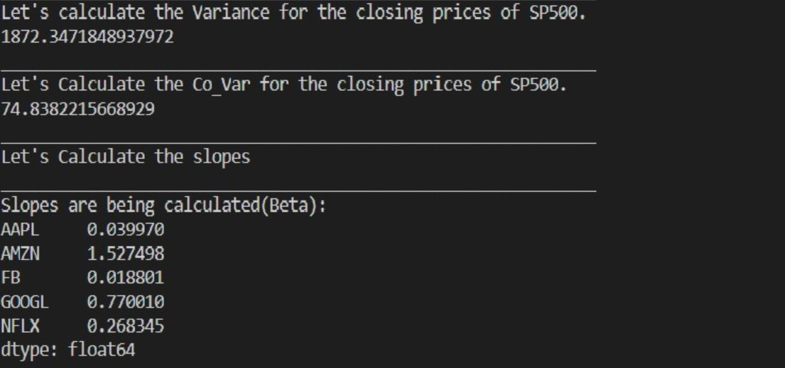
Result Interpretation:
Beta Coefficients -The beta coefficient is the degree of change in the outcome variable for every 1-unit of change in the predictor variable and it indicates the steepness of a line.
Since the beta coefficient is positive for all the independent variable’s we can say that it is significant.

Slide 12



Challenges and Roadblock:
One of the main challenges that our group experienced when arranging this undertaking was deciding how to sample from the dataset and so we experimented with various size windows.
Secondly, we tested our model by running regression on different index like Dow Jones, NASDAQ and S&P 500 and after analyzing we decided to proceed with S&P 500.
Since our sample size was small, our P value was high which indicates that it is statistically insignificant

Slide 13
Future Works:
One approach to make our package a stride further is actualize extra strategies that play out some sort of nonlinear regression. In a portion of our above models, similar to window 170 for AMZN, it gives the idea that some sort of nonlinear regression would be more qualified to demonstrate the conduct. At first glance, it seems like the relationship between the variables would be best described by a polynomial function.
We can also include more independent variables like GDP, unemployment rate, etc to better understand the relationship between the variables i.e. multilinear regression.

Slide 14
Thank You

